Slide 1
NLP PROJECT / 2026
AI-Powered
Research Paper
Analysis & Review
PROJECT BY
Jatin K Sangewar
B.Tech CSE — Data Science
Registration No.
23FE10CDS00283
Turning academic documents into structured research insights
Batch F
GitHub: jatinn-sw
PROJECT OVERVIEW
Problem • Workflow • AI integration • Evaluation

Slide 2
01 / THE NEED
Research is growing. Manual review is slow.
Understanding a paper is only the first step; comparing many papers creates a larger bottleneck.
Volume of literature — Researchers often need to screen many papers before finding relevant work.
Scattered information — Objectives, methods, datasets, results and limitations appear in different sections.
Time-intensive comparison — Manual synthesis makes it difficult to identify patterns and research gaps efficiently.
PROJECT GOAL
Convert unstructured academic text into organized, useful research insights.
AI-Powered Research Paper Analysis
02

Slide 3
02 / PROPOSED SOLUTION
One workspace for initial paper analysis
The application brings document processing and AI-generated insights into a single workflow.
01
02
03
Process
Understand
Inspect
Upload a paper and extract its text for downstream analysis.
Generate a structured review of the paper's purpose, approach and findings.
Present the resulting information through readable sections and visual summaries.
DESIGN PRINCIPLE
Useful analysis should be traceable to the source paper—not treated as unquestionable truth.
AI-Powered Research Paper Analysis
03

Slide 4
03 / FEATURES
What the system is designed to provide
A compact interface for extracting, reviewing and interpreting research content.
Paper upload
AI paper review
Research summary
Bring a research document into the workflow.
Create a structured assessment of key paper sections.
Condense lengthy text into its main ideas.
Metrics & graphs
Confidence indicators
Interactive dashboard
Display analysis results when valid metric data is available.
Communicate reliability only when a meaningful score is calculated.
Make results easy to scan and navigate.
AI-Powered Research Paper Analysis
04

Slide 5
04 / SYSTEM WORKFLOW
From document to research insights
The architecture separates input handling, AI processing and presentation.
01
02
03
04
05
Upload
→
Extract
→
Analyze
→
Structure
→
Display
Research paper
Text & sections
NLP + LLM API
Review & metrics
Dashboard & charts
Validation layer
Check missing fields, malformed values and API errors before rendering results.
AI-Powered Research Paper Analysis
05

Slide 6
05 / AI INTEGRATION
Where NLP and the LLM add value
The LLM interprets document content; the application controls the structure and presentation of its output.
INPUT
PROCESS
OUTPUT
Paper text
→
Prompt + LLM API
→
Structured review
Prompt engineering — Requests consistent fields such as objective, method, findings and limitations.
Structured output — Makes generated content easier to validate and render in the interface.
Human verification — Review findings against the paper; LLM output may be incomplete or incorrect.
AI-Powered Research Paper Analysis
06

Slide 7
06 / IMPLEMENTATION
Technology stack
Replace any placeholder with the exact library or service used in the submitted code.
LANGUAGE
AI LAYER
DOCUMENT LAYER
Python / project language
LLM API + prompt template
PDF/text extraction tools
BACKEND
FRONTEND
VISUALIZATION
Application server / API routes
Web UI and interactive components
Chart library + metric data
Engineering focus
Reliable API handling • validated schemas • clear frontend states • reproducible results
AI-Powered Research Paper Analysis
07

Slide 8
07 / EVALUATION
Validate the output—not just the interface
Evaluation should verify that every displayed result is grounded in real, non-empty analysis data.
WHAT TO TEST
Paper upload and text extraction
KNOWN ISSUES UNDER INVESTIGATION
LLM response and error handling
Metrics / graphs not loading
Possible causes: empty API response, data-shape mismatch, failed chart rendering or missing field mapping.
Review fields populated correctly
Metrics and charts receive valid data
Confidence always equals zero
Confidence values are calculated, not defaulted
Possible causes: calculation not called, default value used, or output key mismatch.
Report measured results only after testing on multiple papers.
AI-Powered Research Paper Analysis
08

Slide 9
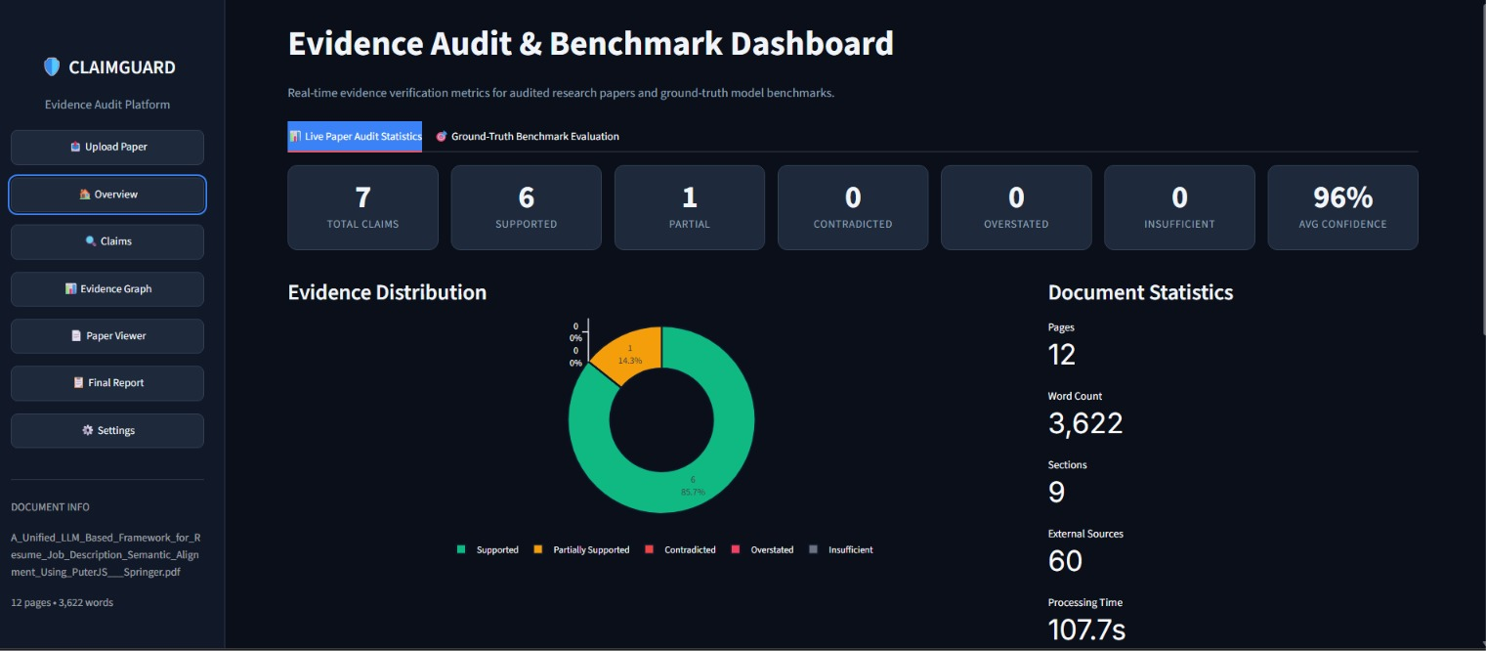
09 / LIVE RESULTS
Real-Time Evidence Audit Dashboard
Live metrics from a full audit of an uploaded research paper — every claim verified against its source.
• 7 claims audited — extracted automatically from the uploaded paper
• 6 supported, 1 partial — no contradicted or insufficient-evidence claims
• 96% average confidence — with an evidence-linked verdict per claim
• 12 pages · 3,622 words · 60 external sources — audited in 107.7s
ClaimGuard — Evidence Audit Platform · Live Paper Audit Statistics tab
AI-Powered Research Paper Analysis
10

Slide 10
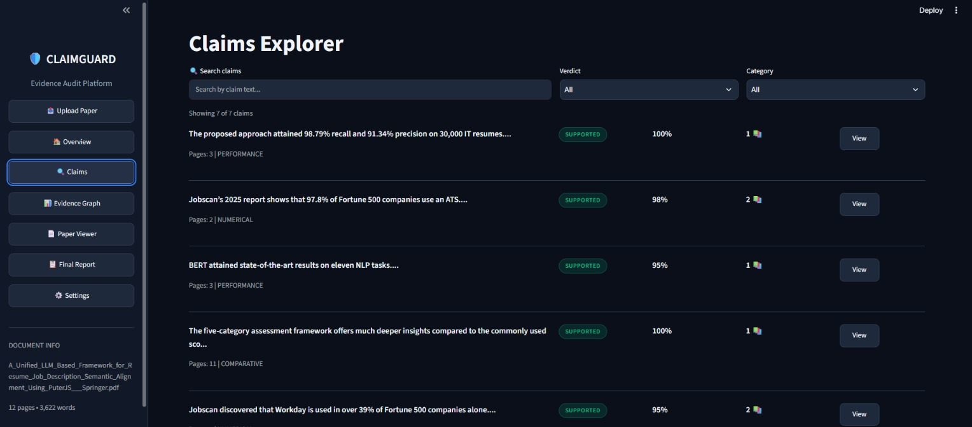
09 / LIVE RESULTS
Claims Explorer — Verdict per Claim
Each extracted claim carries a verdict, confidence score, category and linked evidence sources.
• Claim-level detail — performance, numerical and comparative claims separated
• Verdicts + confidence — SUPPORTED / PARTIAL / CONTRADICTED with per-claim scores
• Evidence counts — every claim links to 1–2 external source documents
• Search & filter — claims can be filtered by text, verdict and category
ClaimGuard — Claims Explorer view (document: LLM-based resume–job alignment paper)
AI-Powered Research Paper Analysis
11

Slide 11
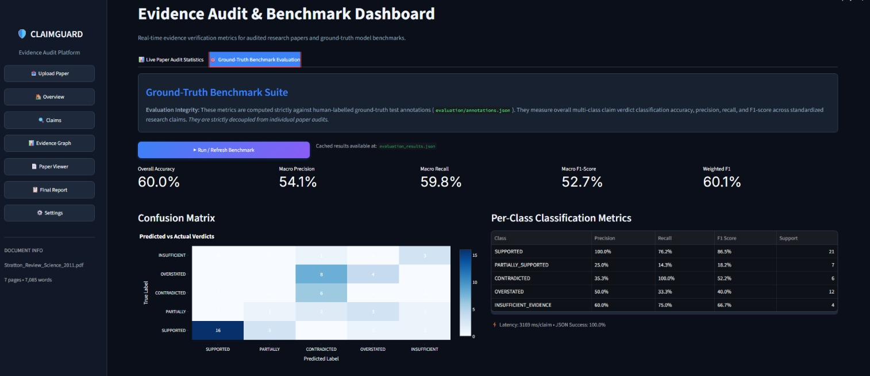
10 / VALIDATION
Ground-Truth Benchmark Evaluation
System verdicts scored against human-labelled annotations — strictly decoupled from individual audits.
• Overall accuracy 60.0% — macro precision 54.1%, macro recall 59.8%
• Macro F1 52.7% — weighted F1 60.1% across five verdict classes
• Per-class metrics — SUPPORTED F1 86.5%; CONTRADICTED recall 100%
• 3,169 ms per claim — 100% structured JSON output success rate
ClaimGuard — Ground-Truth Benchmark Suite (50 human-labelled test claims)
AI-Powered Research Paper Analysis
12

Slide 12
11 / KEY TAKEAWAYS
What the results show
The audit trail and the benchmark together validate both usability and honest system performance.
01
End-to-end workflow verified
upload → extraction → claim detection → verdicts → dashboard, all on a real paper in under two minutes.
02
High-precision audit output
6 of 7 claims fully supported with 96% average confidence and traceable evidence links.
03
Honest, decoupled evaluation
benchmark accuracy (60.0%) is measured against human labels — not inflated by the system's own audits.
04
Clear next steps
improve minority-class recall (PARTIAL / OVERSTATED), lower per-claim latency, and scale to multi-paper comparison.
AI-Powered Research Paper Analysis
13

Slide 13
08 / CONCLUSION
Making research
more structured,
searchable and clear.
NEXT STEPS
Improve metric and chart reliability
Validate confidence-score logic
Compare multiple papers
The system demonstrates how NLP and LLM-based processing can support the first stage of academic paper analysis.
Add evidence-linked research gaps
THANK YOU
Jatin k Sangewar • GitHub: Jatinn-sw

